Slide 1


When to buy and sell a stock?

Slide 2
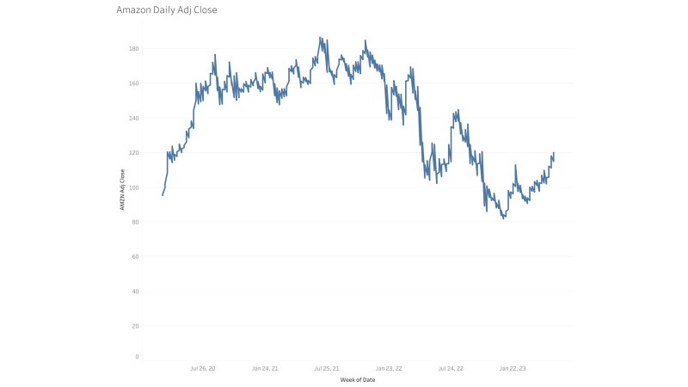
Amazon Stock

Slide 3
The Data
Stock data was provided by Yahoo Financial.
Dates from 1-4-2020 to 5-26-2023
Economic data provided by US Department of Treasury
Same dates applied
Some information is only released quarterly
Data was filled in with last given information
Stock Indicators
RSI
MACD
After data cleaning and wrangling
795 data points were used for modeling and testing

Slide 4
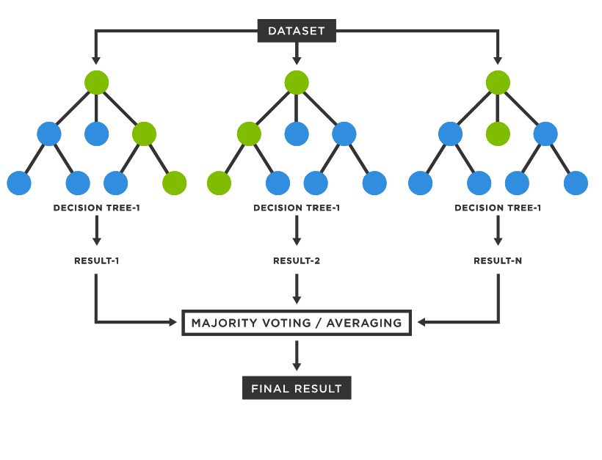
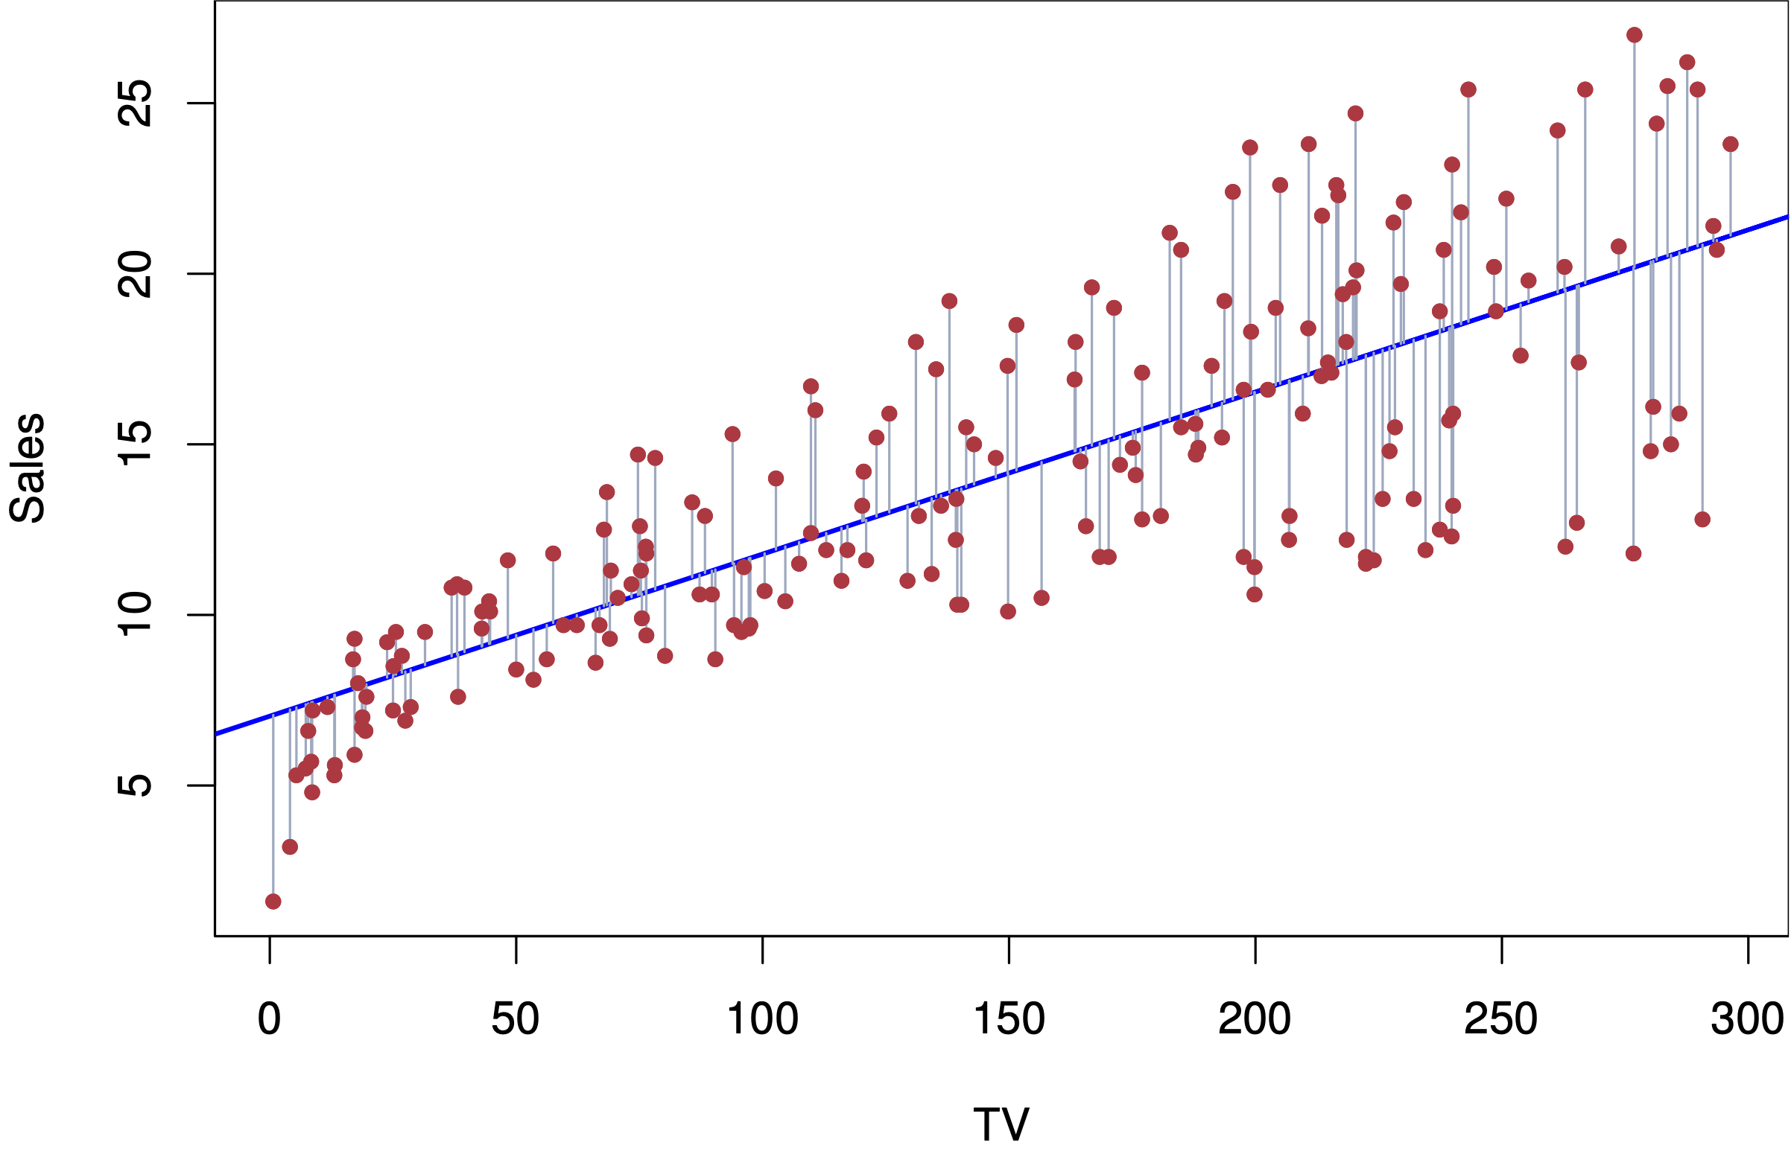
Modeling
Classifier Models
KNN
Bernoulli Naive Bayes
Support Vector
Regression Models
Linear
Random Forest

Slide 5
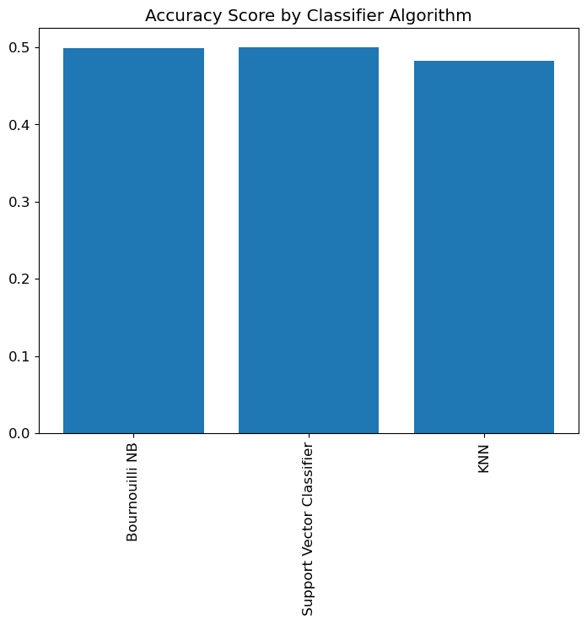
Classifier Modeling Results

Slide 6
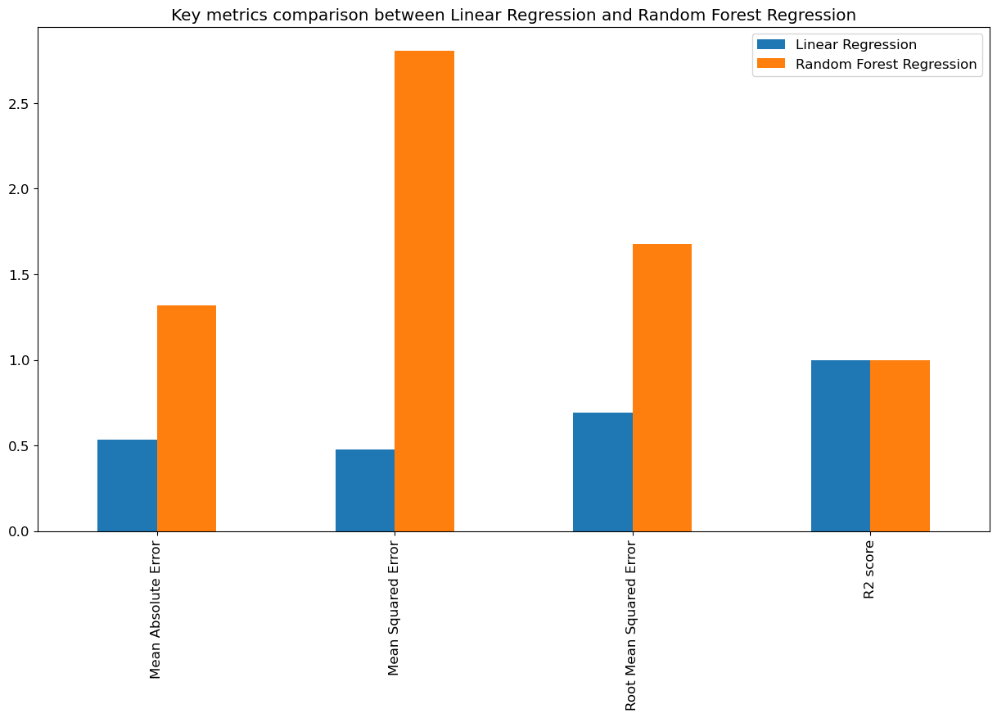
Regression Modeling Results
 | Linear Regression | Random Forest
MAE | .5347 | 1.3176
MSE | .4768 | 2.8057
RMSE | .6905 | 1.675
R2 Score | 99.94% | 99.65

Slide 7
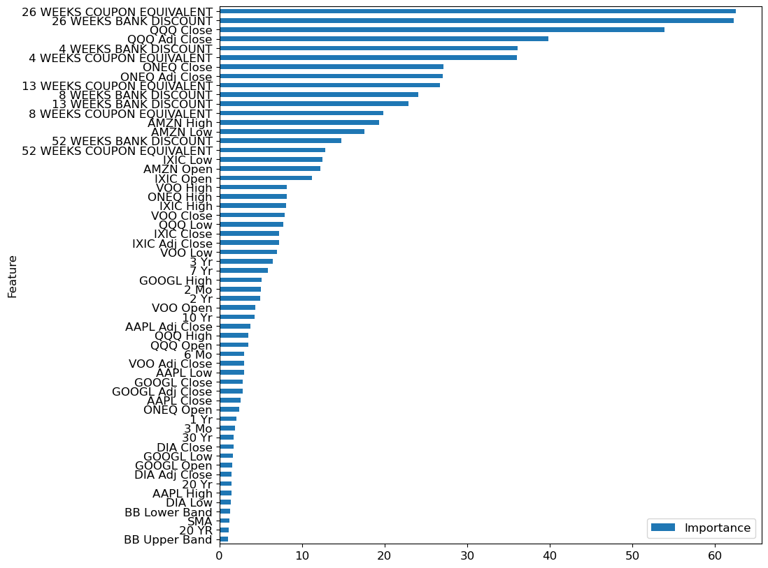
Important Features

Slide 8
What’s Next
Retest with data from the last date to present
Determine what time intervals will be used for trading stock
Test model on a stock simulator
Live Trading

